Slide 1
RUGBY WORLD CUP 2015 CREATIVE WRAP UP
30.11.2015

Slide 2
GLOBE

Slide 3
CALENDAR - CONTENT

Slide 4
RUGBIFIED CELEBRITIES

Slide 5
RUGBYFIED MERCHANT STORIES

Slide 6
DAN CARTER – MAIN AMBASSADOR IMAGE

Slide 7
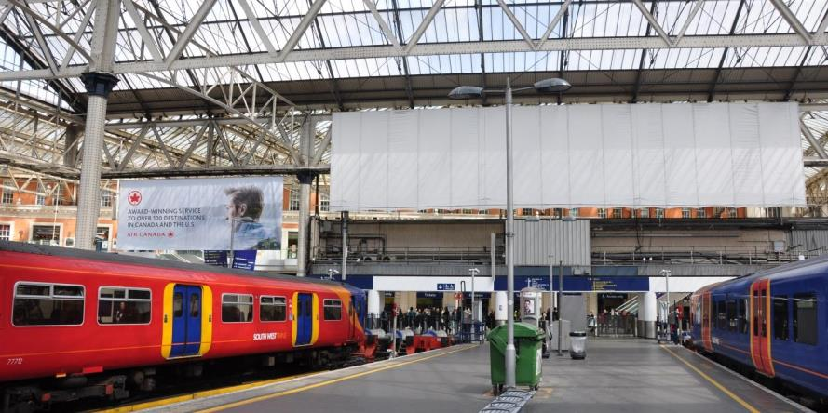
DOUBLE SIDED SAIL BANNER & ENTRANCE BANNER (PLATFORM SIDE)

Slide 8
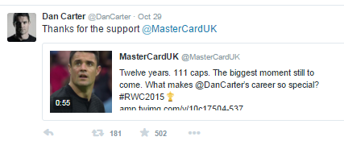
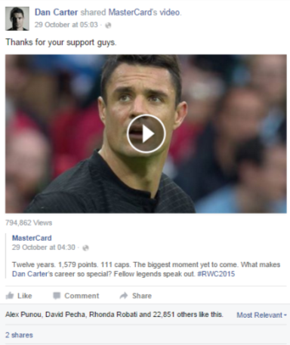
TOP AMBASSADOR TWEETS

Slide 9
CONTENT FILM - UK
Rugby World Cup Sponsorship- Golf and Tennis Films
Click here to watch.
Click here to watch.

Slide 10
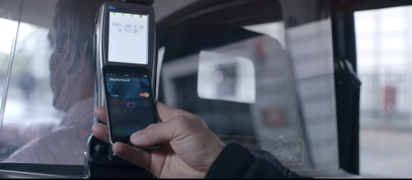
CONTENT FILM - UK
Apple Pay- Launch
Click here to watch.

Slide 11
CONTENT FILM - UK
Apple Pay- Dan Carter Surprise Video
Click here to watch.

Slide 12
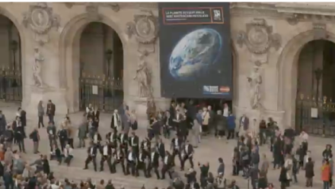
CONTENT FILM - France
Opera Surprise
Click here to watch.

Slide 13
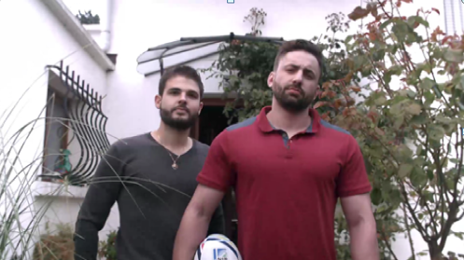
CONTENT FILM - France
Chabal Surprise Video
Click here to watch.

Slide 14
THANK YOU.

